Slide 1
Data mining using Excel
Fatima GASMI | ESGI

Slide 2
Introduction
Fatima GASMI
Lead Data Scientist @ALLIANZ TRADE
Fatimazahrae.gasmi@gmail.com
Please put ESGI in the subject of your email

Slide 3
Index
Introduction
Collecting and Importing Data in Excel
Data tabs
Number and Formulas
First statistical approach
Data discovery and exploration
Visualizing data

Slide 4

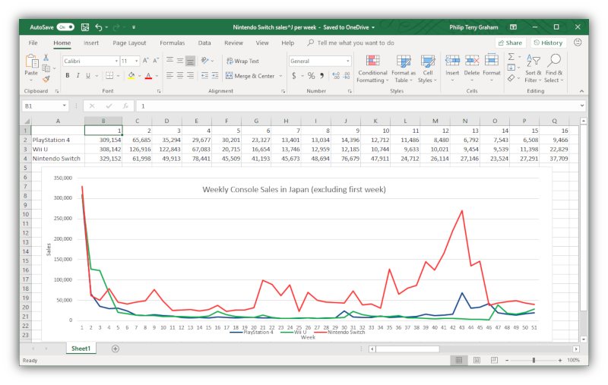
Introduction
What is Excel ?
Microsoft Excel is a spreadsheet developed by Microsoft for Windows, macOS, Android and iOS.
It features calculation or computation capabilities, graphing tools, pivot tables, and a macro programming language called Visual Basic for Applications (VBA)
Excel forms part of the Microsoft Office suite of software.

Slide 5

Introduction
What is Data Mining ?
“…the process of discovering meaningful new correlations, patterns, and trends by sifting through large amounts of data…” (Gartner Group)
“…the analysis of observational data sets to find unsuspected relationships and to summarize data in novel ways…” (Hand et al.)
“…is an interdisciplinary field bringing together techniques from machine learning, pattern recognition, statistics, databases, and visualization…” (Cabana et al.)
… is the exploration and analysis of large quantities of data in order to discover previously unknown meaningful and actionable patterns and rules (adapted form Berry and Linoff)

Slide 6
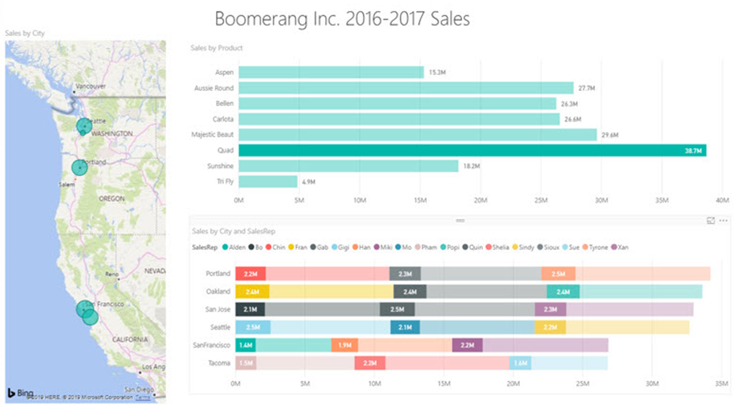
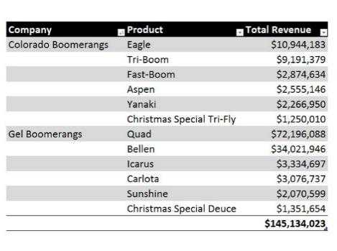




Introduction
Data Mining using Excel
Using Excel computing capabilities and features to Convert Raw Data into Useful Information for Decision Makers
Build Reports, Visualizations and Dashboards that Deliver Useful Information
Data Mining
Import Data in Excel
Collect Data
Clean & Transform Data
Build Data Model

Slide 7
Collecting Data
Relational databases, such as SQL Server, Oracle, MySQL, and IBM DB2, are used to store data in an organized manner in these systems. Data from databases and data warehouses can be utilized as an analysis source.
Data
Database
API
Open Data
Web Scraping
Web scraping is a technique for obtaining meaningful data from unstructured sources. Online scraping, allows to retrieve data from websites depending on predefined parameters.
APIs, or Application Program Interfaces, and Web Services are provided by many data providers and websites, allowing various users or programs to communicate with and access data for processing or analysis.
Open data is data that is openly accessible, exploitable, editable and shared by anyone for any purpose, even commercially. Open data is licensed under an open license.

Slide 8
Importing Data in Excel
Why importing Data ?
Cell by cell input is no longer suitable when a large amount of data must be processed. A standard input format is then necessary.
Multiple ways are available in Excel to enter bulk data in a spreadsheet :
TXT / CSV
XML
Web
Database

Slide 9
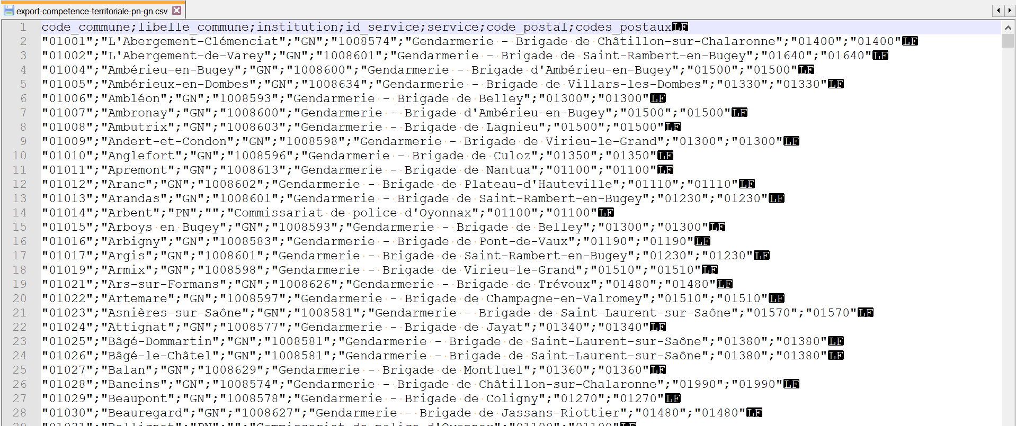
Importing Data in Excel
Importing CSV file – Part 1
One is the most common way to store data is to use the CSV format “Comma Separated Values".
A CSV file is a text file, containing data on each line separated by a separator character (usually a semicolon, comma, or tab).
Columns Headers are in the 1st line
Fields separator is semicolon

Slide 10
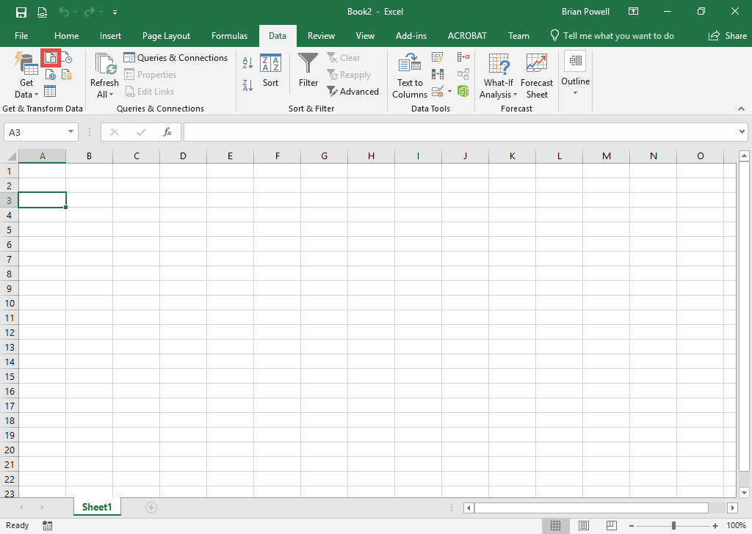
Importing Data in Excel
Importing CSV file – Part 2
Click the cell where you want to import the CSV file.
Go to the Data ribbon.
Click the From Text/CSV button.
Select the CSV file to import.
Click the Import button.
Click the Transform Data button.

Slide 11
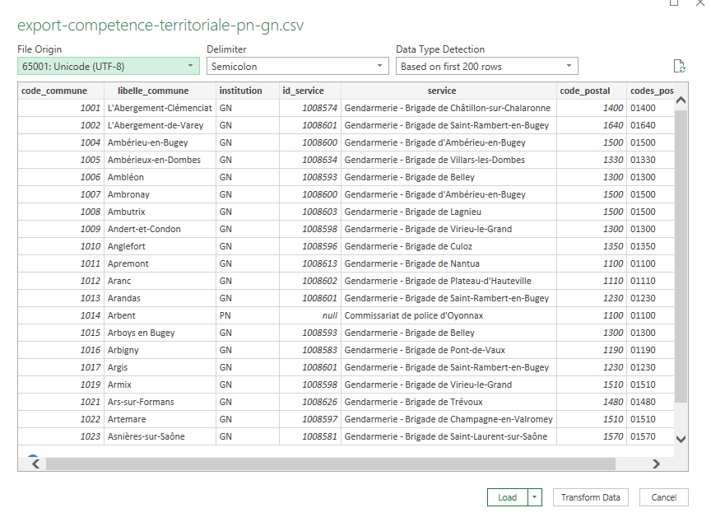
Importing Data in Excel
Importing CSV file – Part 3
Click the Transform Data button.

Slide 12
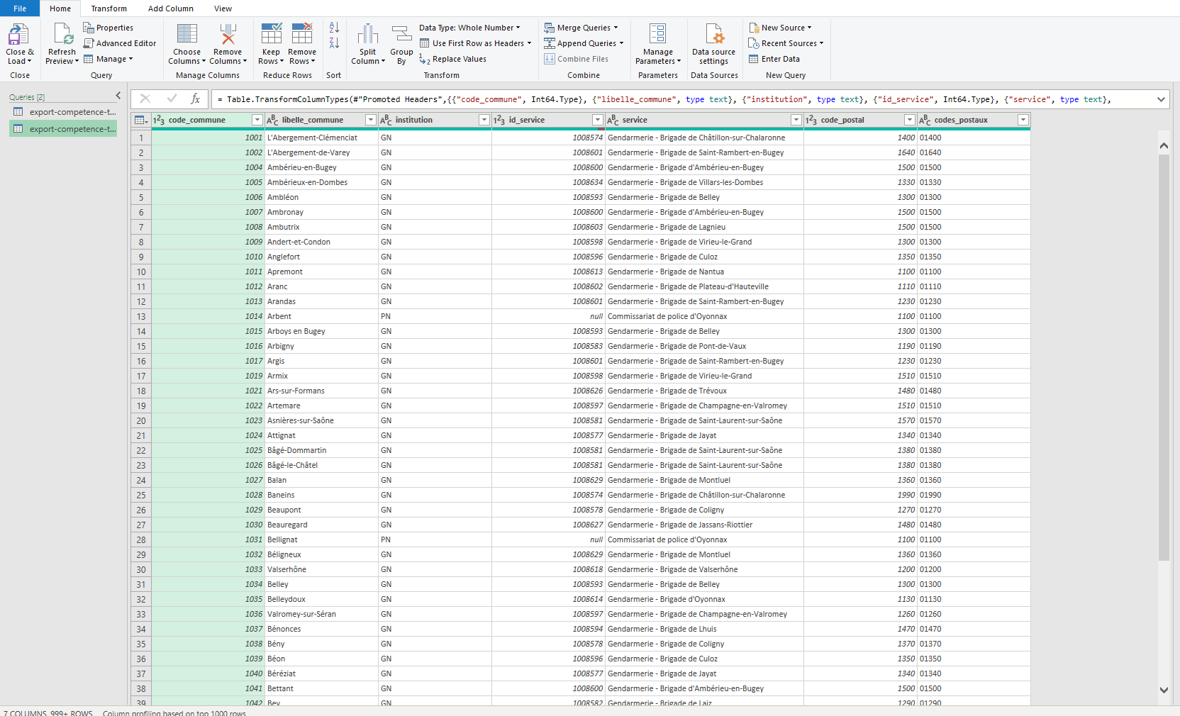
Importing Data in Excel
Importing CSV file – Part 4
Look at the table of data to ensure that the heading at the top contains names for the columns and not data.
If column headings aren’t shown, click the Use First Row as Headers button.

Slide 13
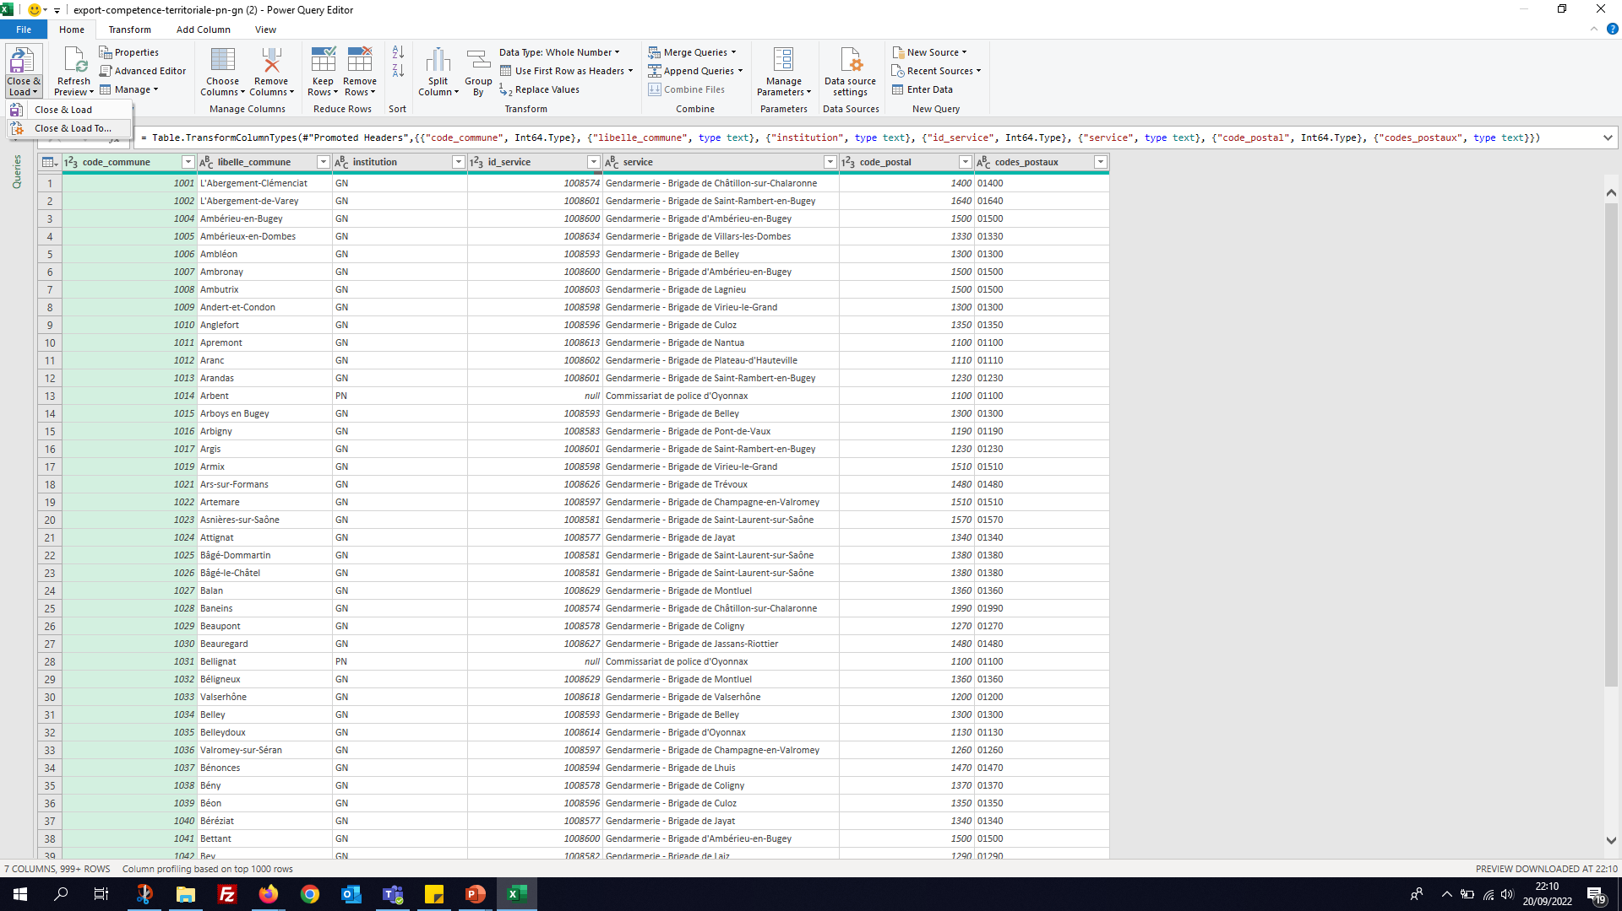
Importing Data in Excel
Importing CSV file – Part 5
Click the dropdown arrow below the Close & Load button and select Close & Load To.
Select that you would like to view this data as a table in the existing worksheet. The cell you selected will be listed.
Click the OK button.

Slide 14
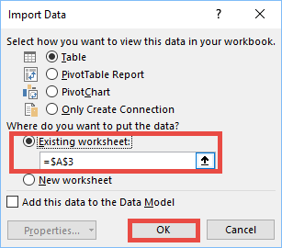
Importing Data in Excel
Importing CSV file – Part 6
In the Import Data dialog box, choose to put the data on an Existing sheet.
Check the cell location. Fix it if it’s not the right cell.
Click the OK button to perform the import.
Démo

Slide 15
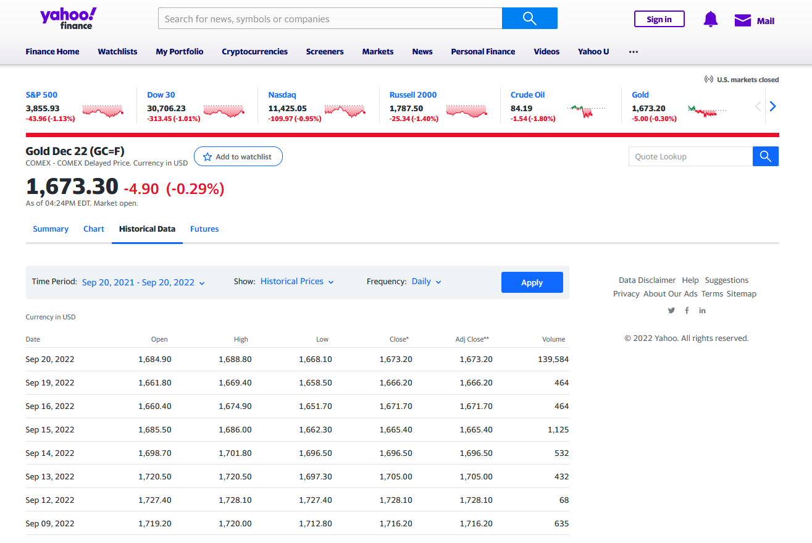
Importing Data in Excel
Importing Data from a Webpage – Part 1
Let’s assume that we need for our data mining project, we need to include the historical data of Gold Market in the analysis.

Slide 16
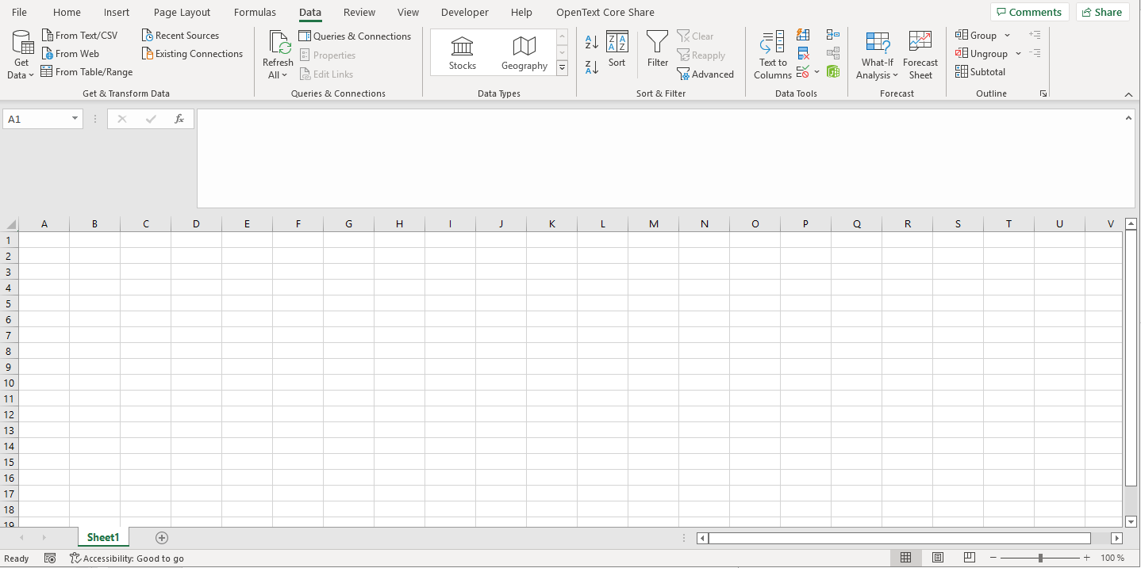
Importing Data in Excel
Importing Data from a Webpage – Part 2
Click the first cell on the worksheet to contain the imported data
Click the From Web button to display the From Web dialog box

Slide 17
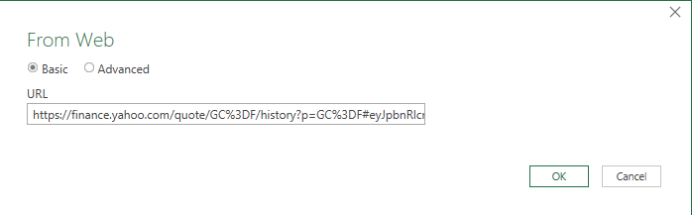
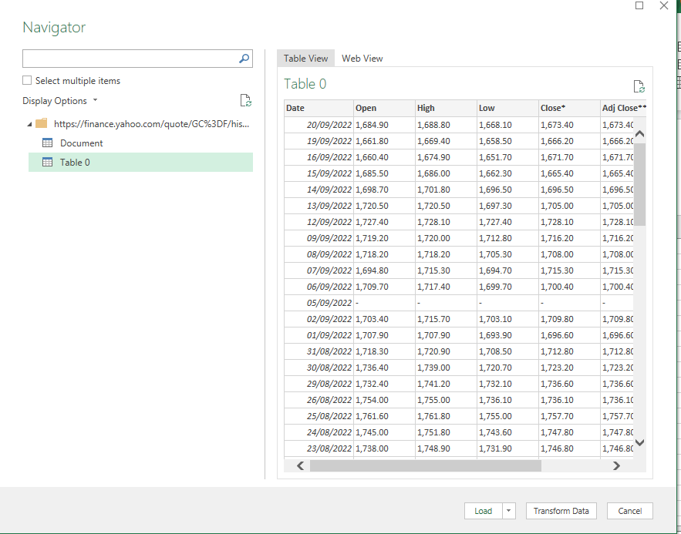
Importing Data in Excel
Importing Data from a Webpage – Part 3
Type the Web page address in the URL box
Click OK to display the Navigator dialog box
Click the table name
Click the Transform Data button to display the Power Query Editor window

Slide 18
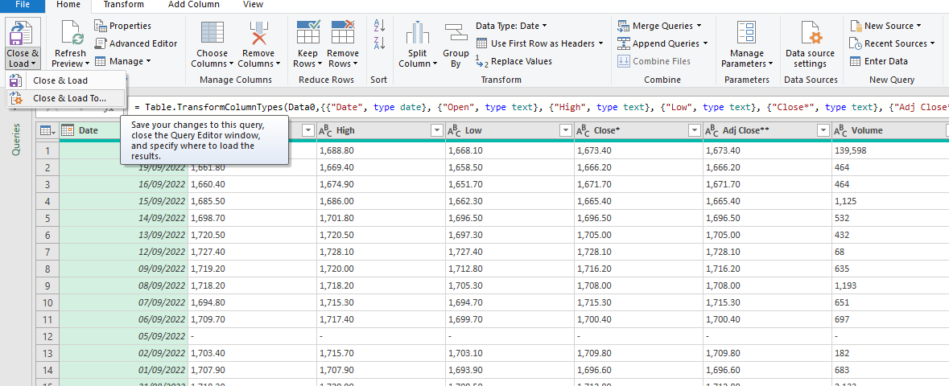
Importing Data in Excel
Importing Data from a Webpage – Part 4
Make desired selections
Click the Close & Load arrow and then click the Close & Load To command to close the Power Query Editor Window
When Excel displays the Import Data dialog box, click the Existing worksheet option button.
Click OK to import the data
Démo

Slide 19
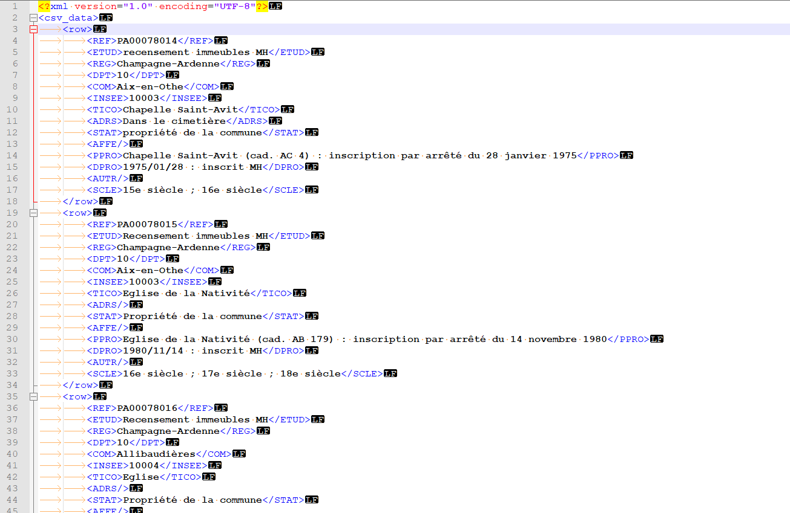
Importing Data in Excel
Importing Data from XML – Part 1
XML (Extensible Markup Language) is a markup language like HTML, but without predefined tags to use.
It is a powerful way to store data in a format that can be stored, searched, and shared.

Slide 20
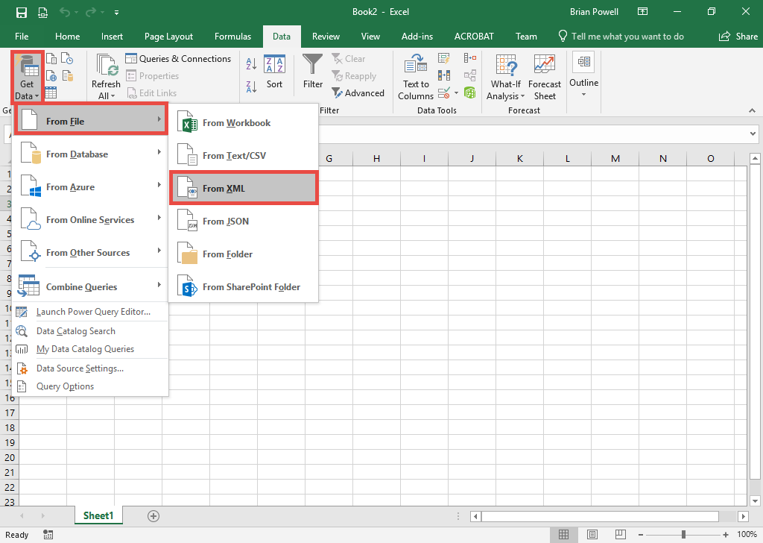
Importing Data in Excel
Importing Data from XML – Part 2
Click the cell where you want to import the XML file.
Go to the Data ribbon.
Click the Get Data button, select From File and then From XML.
Select the XML file to import.
Click the Import button.

Slide 21
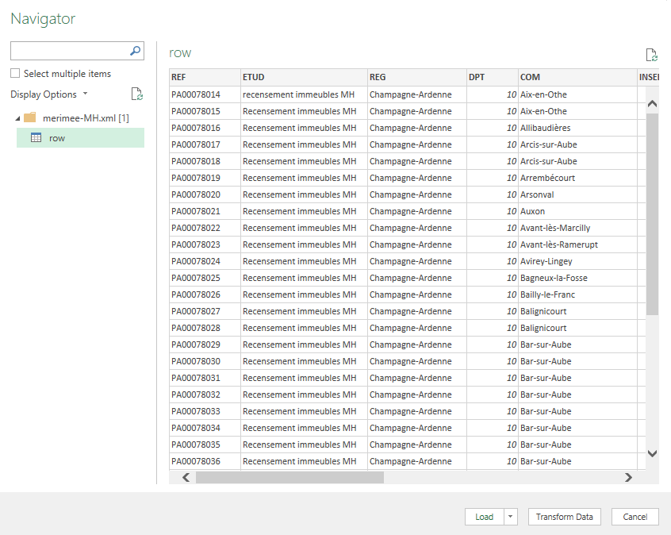
Importing Data in Excel
Importing Data from XML – Part 3
On the left pane of the Navigator dialog box, select the table you wish to import.
Click the Transform Data button.

Slide 22
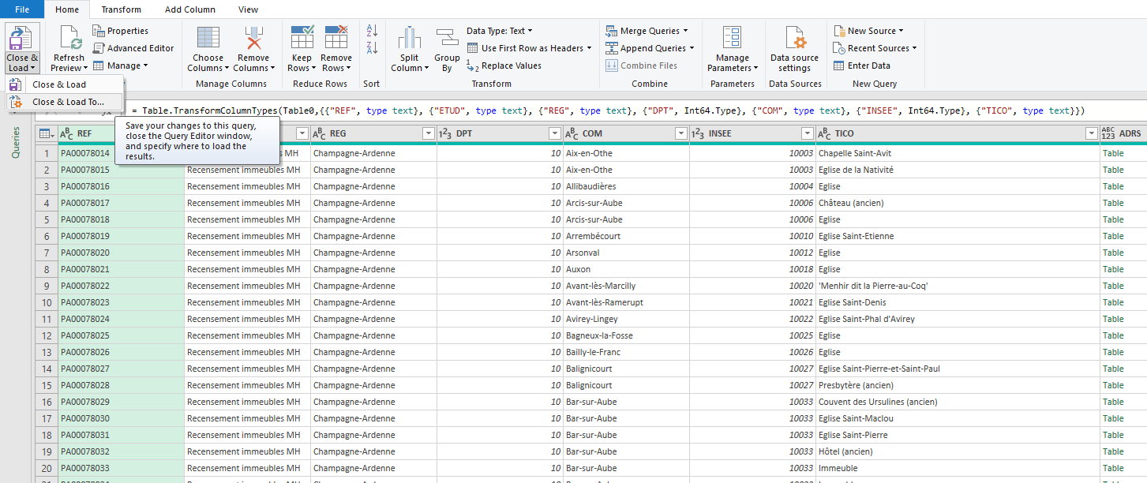
Importing Data in Excel
Importing Data from XML – Part 4
Click the dropdown arrow below the Close & Load button and select Close & Load To.
Select that you would like to view this data as a table in the existing worksheet. The cell you selected will be listed.
Click the OK button.
Démo

Slide 23
Data Tables
What is a Data Table ?
A range of data that is treated as a distinct object in a worksheet ➔ makes it easier to identify, manage, and analyze the related data.
In addition, the entire table is formatted using a single table style, a preset style that speciﬁes the formatting for an entire table.
Data tables can include optional elements such as :
a header row that contains titles for the different columns in the table
a total row that contains formulas summarizing the values in the table’s data.
You can create more than one Data table in a worksheet.

Slide 24
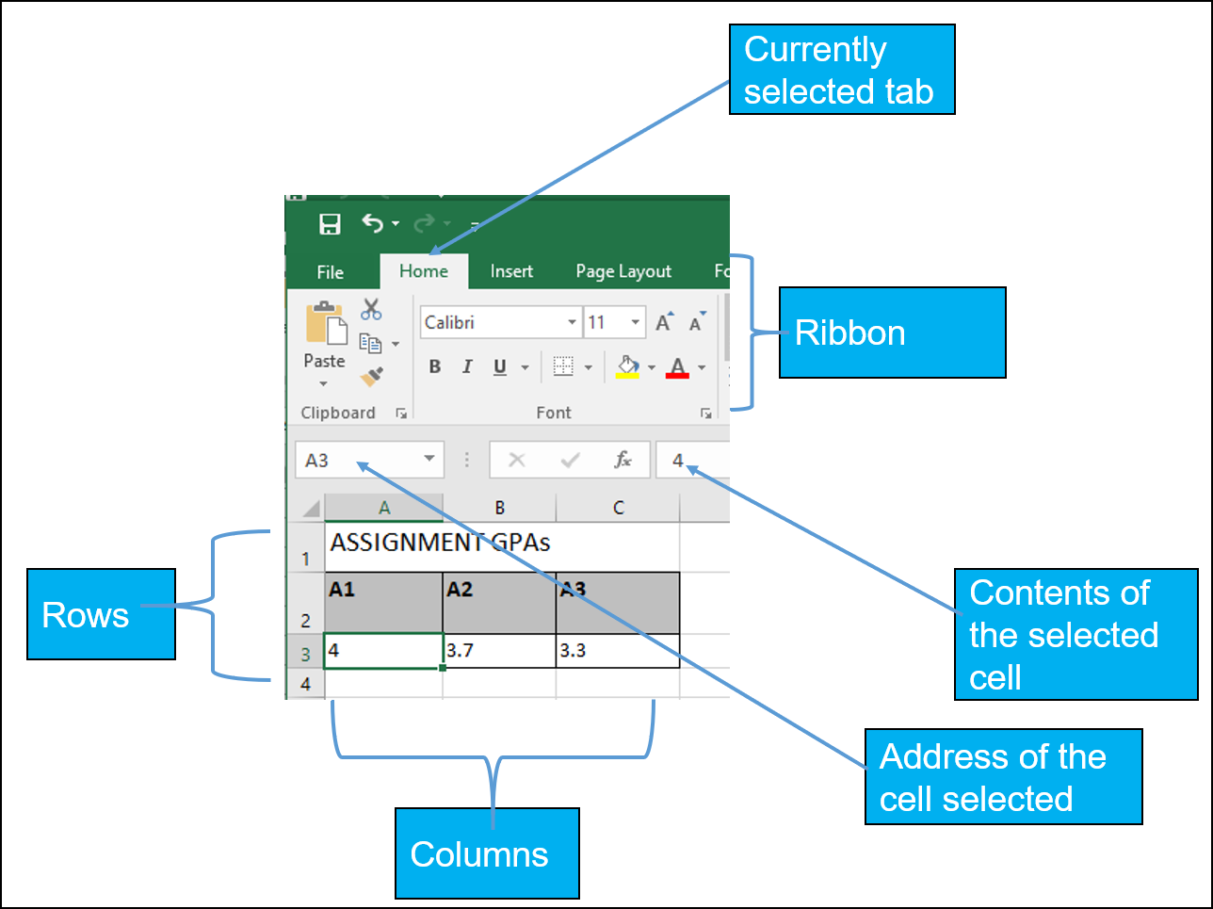
Data Tables
Basics

Slide 25
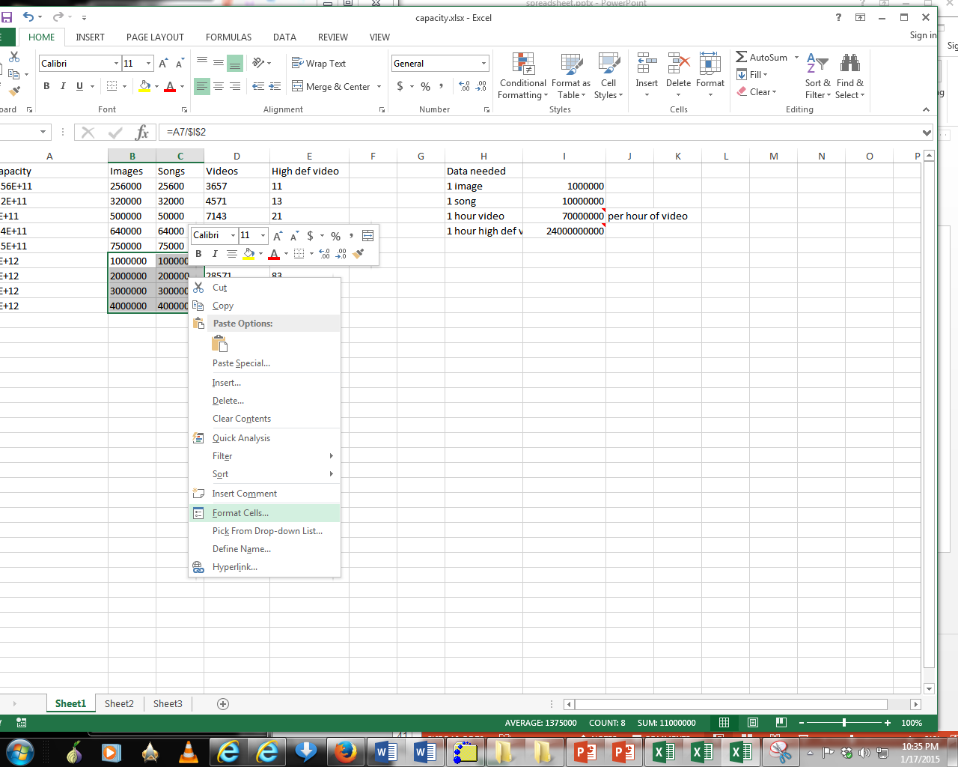
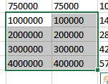
Data Tables
Data Format – Part 1
Excel provides the ability to format data in various locations of the ribbon.
You also can access these functions in the context of a cell or cells in the Data table.
Select a cell or cells for which you wish to apply similar formatting effects.
Right click and select Format Cells

Slide 26
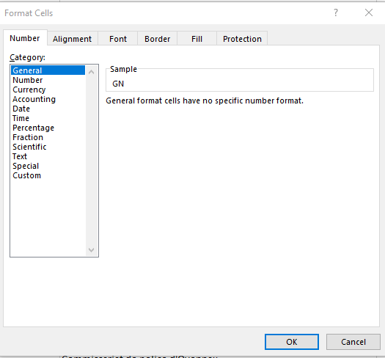
Data Tables
Data Format – Part 2
Choices Of Cell Data:
General: No special format
Number:
Separator (1 comma for 3 digits)
Several options for displaying negative numbers
Currency:
Currency sign appears
Several options for displaying negative numbers
Columns aligns decimal points
Accounting:
Like currency but no special options for displaying negative values
Date, Time:
Both allow the display to appear in different formats
Percentage: E.g., 100%
Fraction: e.g., when 0.75 is typed in it displays as 3/4

Slide 27
Data Tables
Data Format – Part 3
Scientific: 1.23E+06
Decimal point shifting = Exponent
Text:
Treats everything (even numbers) as text
Cell data is displayed exactly as entered.
Special:
Country specific information e.g., ZIP code
Custom:
You can create your own formats e.g., ID number = A22-B (alpha, two digits, dash, alpha)

Slide 28
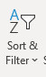
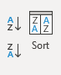
Data Tables
Data Sorting – Part 1
You can sort data using:
Home Tab
Data Tab commands
Right click and from the shortcut menu use the sort item and the menu,

Slide 29
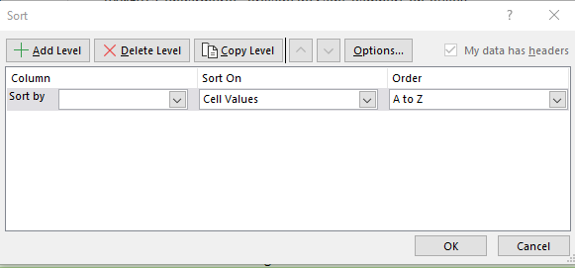
Data Tables
Data Sorting – Part 2
With a data table you may click in a cell and sort your column in various ways,
Numbers – Smallest to Largest or Largest to Smallest,
Dates – Oldest to Newest or Newest to Oldest,
Text – A to Z or Z to A,
Use the Custom Sort command to sort by more than one column,
Excel worksheets that are not in a data table arrangement require you to select the area you wish to sort and use the Custom Sort command to sort by the column(s) you wish.

Slide 30
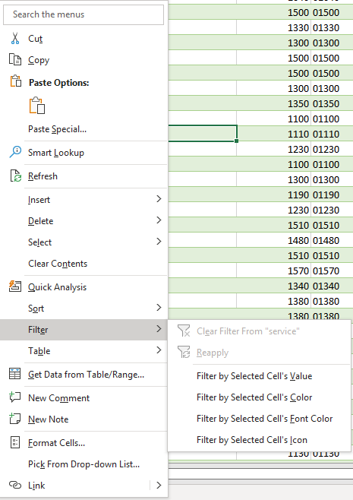
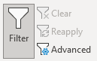
Data Tables
Data Filtering – Part 1
You can filter data using:
Home Tab
Data Tab commands
Right click and from the shortcut menu use the filter item and the menu,

Slide 31
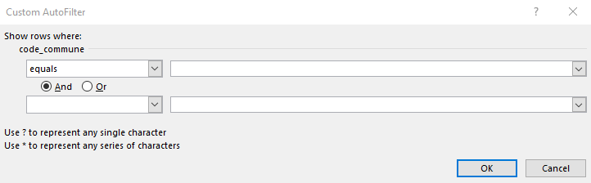
Data Tables
Data Filtering – Part 2
Small filtering arrows appear in your field names/column headers from which you may choose specific text, date, or numbers,
The filtering menu allows you to customize your filter for Number Filters, Date Filters, and Text Filter fields,
Numbers - Use between for number ranges, greater than, less than, and Top 10 criteria for numbers,
Dates - Use relative dates (Next Week, Last Year) or between for ranges,
Text - Use contains for character within a text, begins with, ends with, and so on,
The Custom Filter menu allows you to perform multiple criteria for your data.

Slide 32
Numbers and Formulas
Not all Numbers in Excel are true numbers, such a Security Social Number, Phone Number..
Here are the three criteria for a number in Excel:
No leading zeroes,
No special format (-, ?, space, :,) Number formats are monetary ($1,000), decimal (98.6), percent (110%), exponents 1028 etc.,
Used in calculations.
Formulas and Functions Syntax
Begin with equal sign = (for old timers the +),
Colon : ➔ A range of cells =SUM(B5:B55),
Comma , ➔ Non-Contiguous cells =AVERAGE(B6,D10,E55) and function delimiter =PMT(D5,D6,D7),
Must have parenthesis () =TODAY(),
Absolute and Mixed References $ ➔ ($A$1) or B$5,
Reference and Worksheet/Workbook linkage ! ➔ =SUM(January:December!B5) or =January!D100.

Slide 33
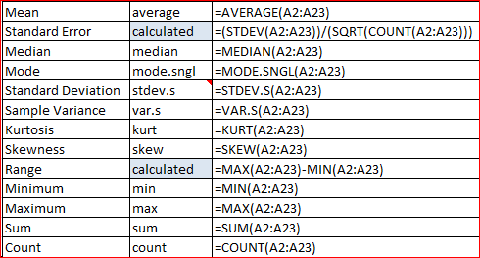
First Statististical Analysis
SUM – Adds or totals numbers in a column, row, or cells,
AVERAGE – Averages numbers in a column, row, or cells,
COUNT – Counts numbers in a column, row, or cells,
COUNTA – Counts nonblank/empty cells in a column, row, or cells regardless of text, number, or date data types,
MEDIAN – returns the middle value of a {sorted} list of supplied values
If an odd # of values in the list, then middle number
If an even # of values in the list, then the average of the two middle numbers
MODE.SNGL – returns the most frequently occurring value of a list of supplied numbers
What if there’s a tie? ➔ first one listed (lowest if sorted)
STDEV.S – returns the standard deviation of a supplied set of values (which represent a sample of a population)
A measure of how spread out the numbers are (square root of the variance)
VAR.S – returns the variance of a supplied set of values (which represent a sample of a population)
The average of the squared differences from the mean (average)
Notes:
Variance = mesure de la dispersion des valeurs d'un échantillon

Slide 34
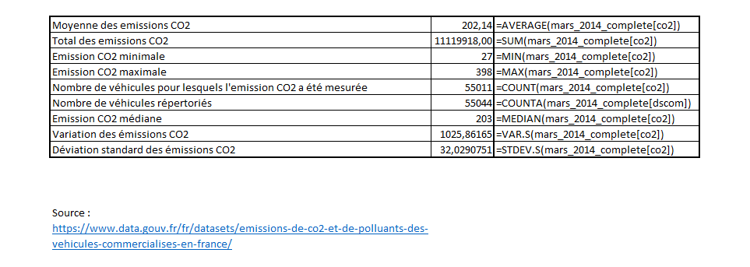
First Statististical Analysis
Example
Démo

Slide 35
Intermediate Statististical Analysis
SUMIFS – Adds or totals numbers in a column, row, or cells, that meet multiple conditions
AVERAGEIFS – Averages numbers in a column, row, or cells, that meet a multiple conditions
COUNTIF – Counts numbers in a column, row, or cells, that meet a single condition
IF – Returns TRUE if logical condition is met
AND – Return TRUE if all logical conditions are true
OR– Returns TRUE if one or more conditions is true

Slide 36
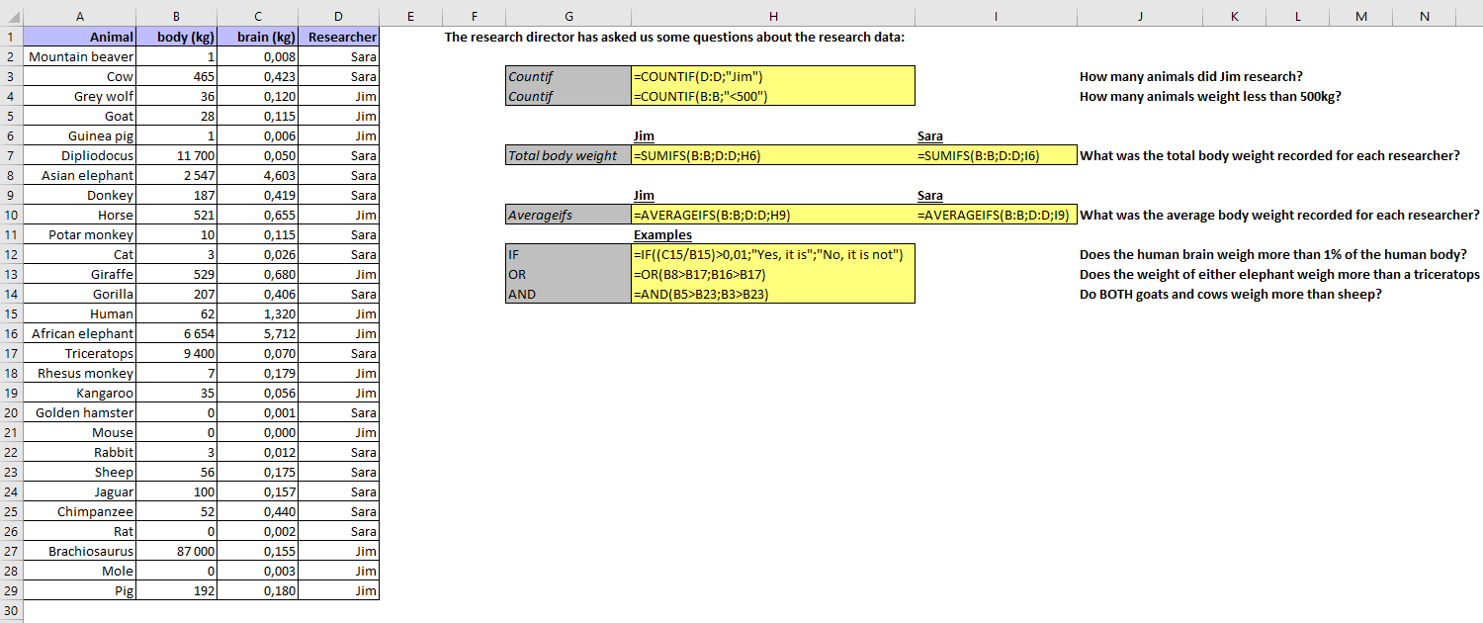
Intermediate Statististical Analysis
Example : AnimalsIntFunctions.xlsx
Démo

Slide 37
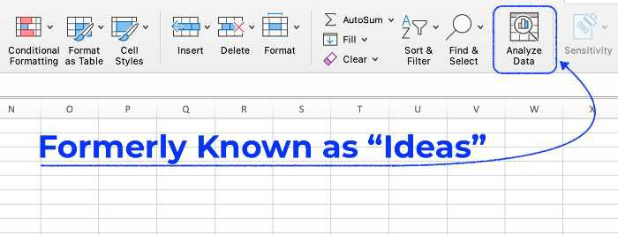
Data Exploration
What is Data Exploration?
Data exploration refers to the initial step in data analysis in which data analysts use data visualization and statistical techniques to describe dataset characterizations, such as size, quantity, and accuracy, in order to better understand the nature of the data.
Analyze Data Feature in Excel
Excel’s Analyze Data function is a powerful and easy-to-use tool for exploring data or data analytics. It can quickly identify relationships between variables and produce helpful visualizations.

Slide 38
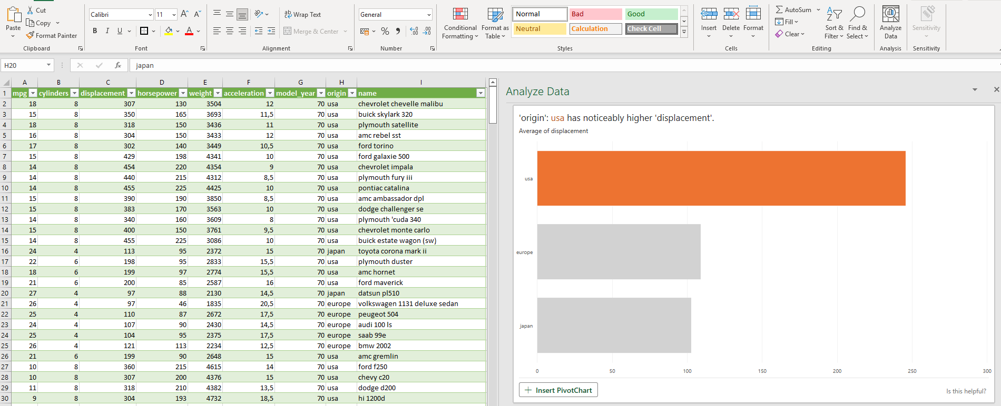
Data Exploration
Example 1 : Automobile Data (mpg.csv)
Démo

Slide 39
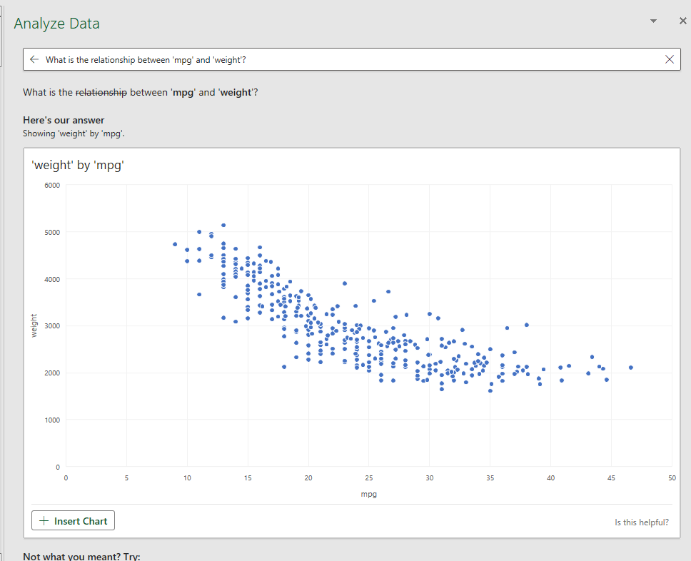
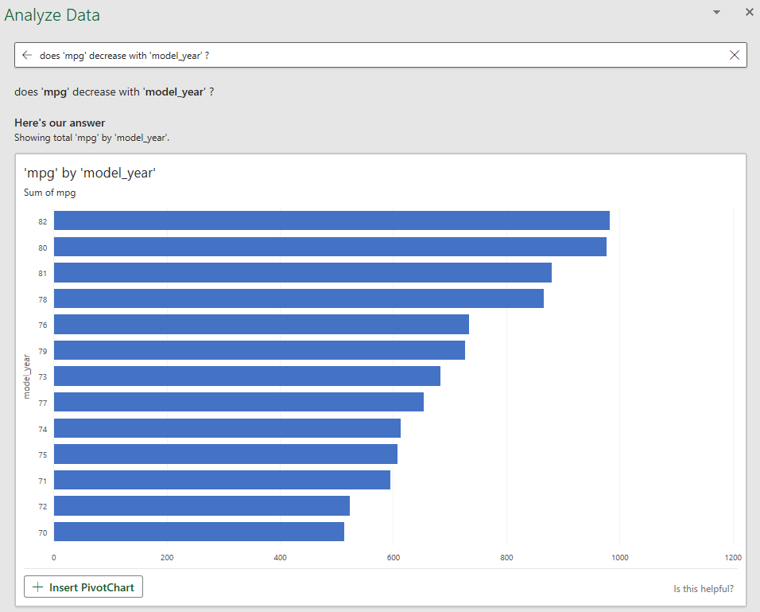
Data Exploration
Example 1 : Automobile Data (mpg.csv)

Slide 40
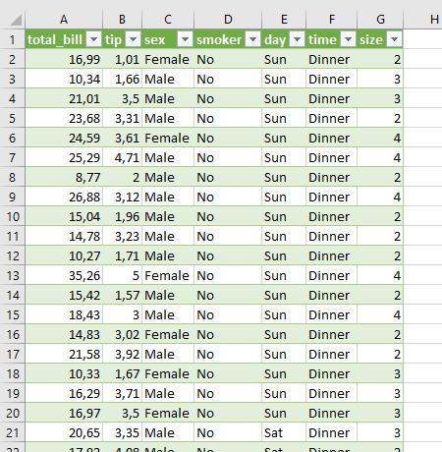
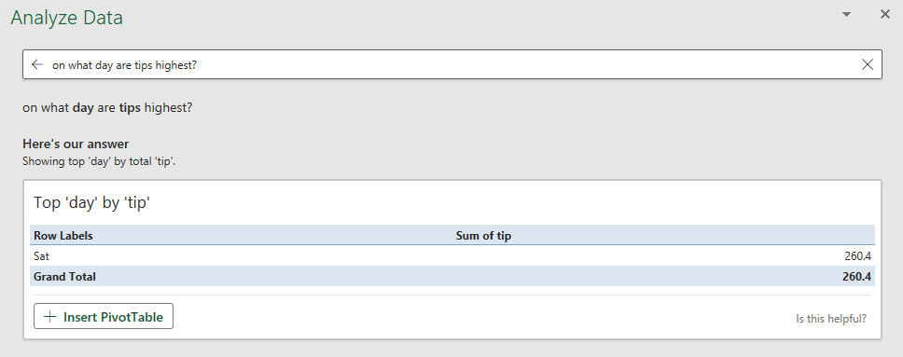
Data Exploration
Example 2 : Tips (tips.csv)
Data Source : https://github.com/mwaskom/seaborn-data

Slide 41
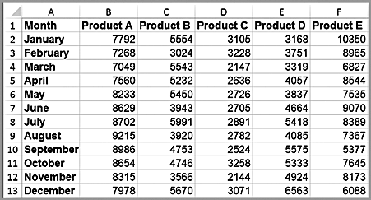
Data Visualization
What is Data Visualization ?
The process of displaying data (often in large quantities) in a meaningful fashion to provide insights that will support better decisions.
Data visualization improves decision-making, provides managers with better analysis capabilities that improves collaboration and information sharing.
Tabular vs. Visual Data Analysis
Tabular data can be used to determine exactly how many units of a certain product were sold in a particular month, or to compare one month to another.
For example, we see that sales of product A dropped in February, specifically by 6.7% (computed as 1 – B3/B2). Beyond such calculations, however, it is difficult to draw big picture conclusions

Slide 42
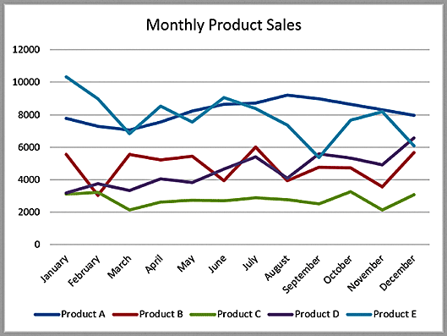
Data Visualization
Tabular vs. Visual Data Analysis
A Visual Chart provides the means to :
Easily compare overall sales of different products (Product C sells the least, for example);
Identify trends (sales of Product D are increasing), other patterns (sales of Product C is relatively stable while sales of Product B fluctuates more over time), and exceptions (Product E’s sales fell considerably in September).

Slide 43
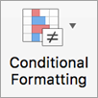
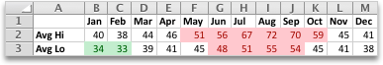
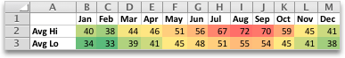
Data Visualization
Conditional Formatting
Conditional formatting makes it easy to highlight certain values or make cells easy to identify. This changes the appearance of a cell range based on a condition (or criteria). You can use conditional formatting to highlight cells that contain values which meet a certain condition. Or you can format a whole cell range and vary the exact format as the value of each cell varies.
Temperature information with conditional formatting applied that shows top 10% and bottom 10% values
Temperature information with 3-color scale conditional formatting applied
➔ Usefull tool to highlight Patterns and Trends

Slide 44
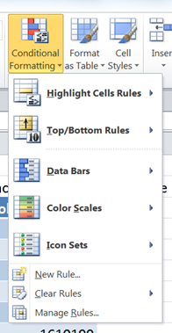
Data Visualization
Conditional Formatting
Excel has four conditional formats:
Highlight Cells Rules - Apply formatting to cells that satisfy a specific condition
Top/Bottom Rules - Apply formatting to cells that satisfy a statistical condition in relation to other cells in the range
Data Bars / Color Scales / Icon Sets - Apply formatting to all cells in the range, depending on their value in relation to one another;
New rule – Apply a custom rule
Clear rules – Removes all the rules that have been applied to the worksheet.
Manage Rules – View or edit the conditions that have been set

Slide 45
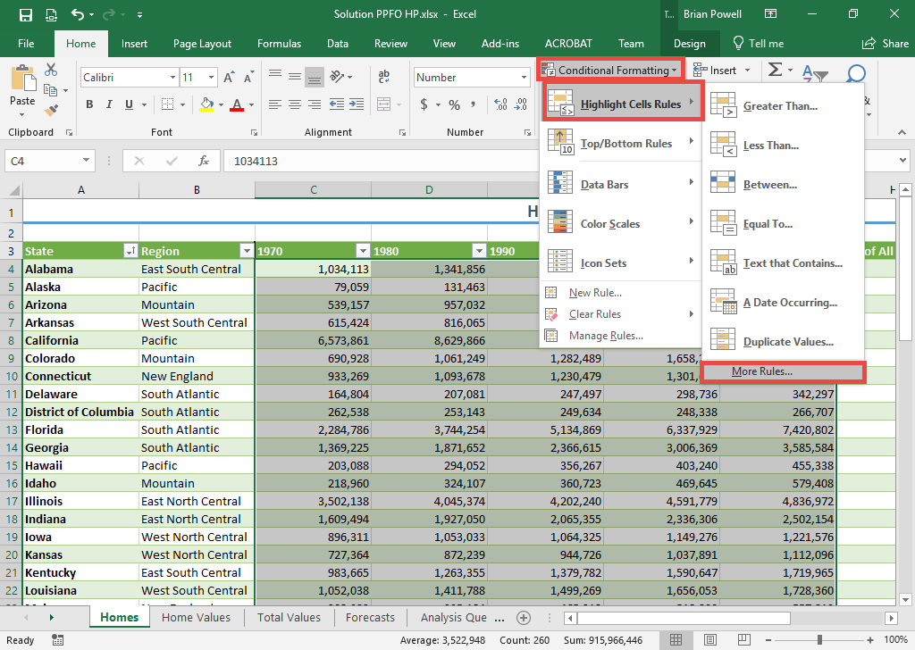
Data Visualization
Conditional Formatting
Highlight Cells Rules
Select the range of cells where you wish to apply conditional formatting.
Go to the Home ribbon.
In the Styles section, click Conditional Formatting
Select Highlight Cells Rules and then select More Rules.

Slide 46
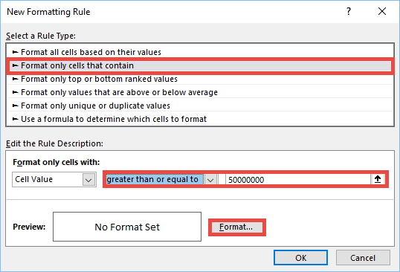
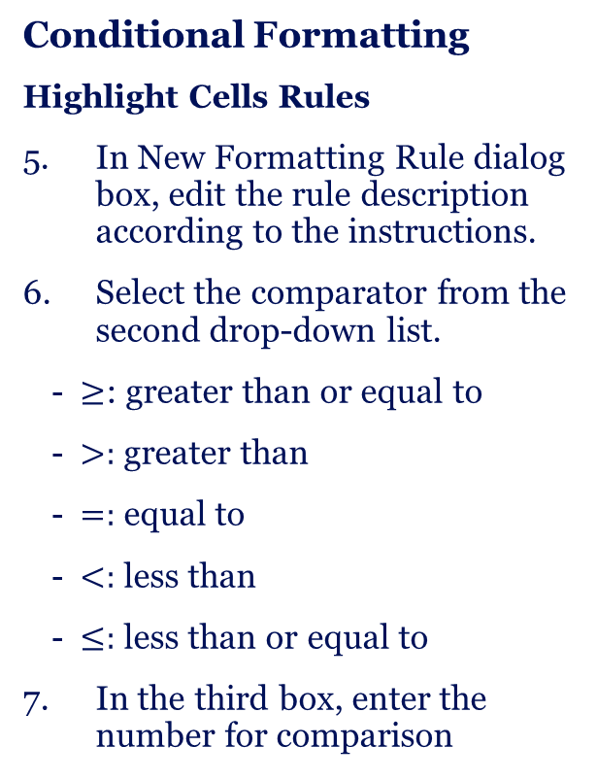
Data Visualization
Conditional Formatting
Highlight Cells Rules
In New Formatting Rule dialog box, edit the rule description according to the instructions.
Select the comparator from the second drop-down list.
$≥$: greater than or equal to
$>:$ greater than
$=:$ equal to
$<:$ less than
$≤:$ less than or equal to
In the third box, enter the number for comparison

Slide 47
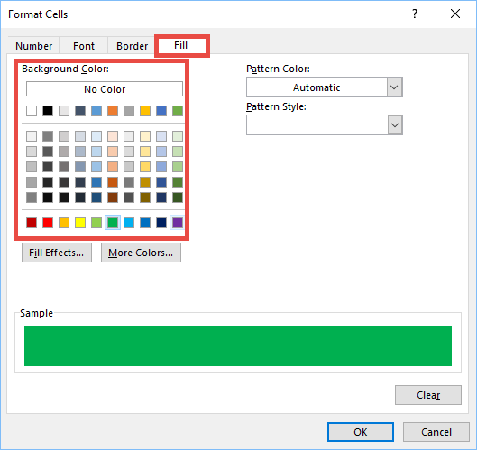
Data Visualization
Conditional Formatting
Highlight Cells Rules
Change the cell fill color:
Click Format.
Go to the Fill tab.
Select the fill color as required

Slide 48
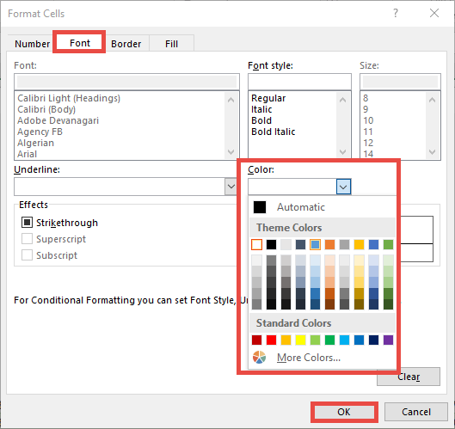
Data Visualization
Conditional Formatting
Highlight Cells Rules
Change the text color:
Go to the Font tab.
In the Color section, click the dropdown list to expand different color options.
Select the desired text color.
Click the OK button to return to the New Formatting Rule dialog box.
Click the OK button to apply the conditional formatting to the selected cells.

Slide 49
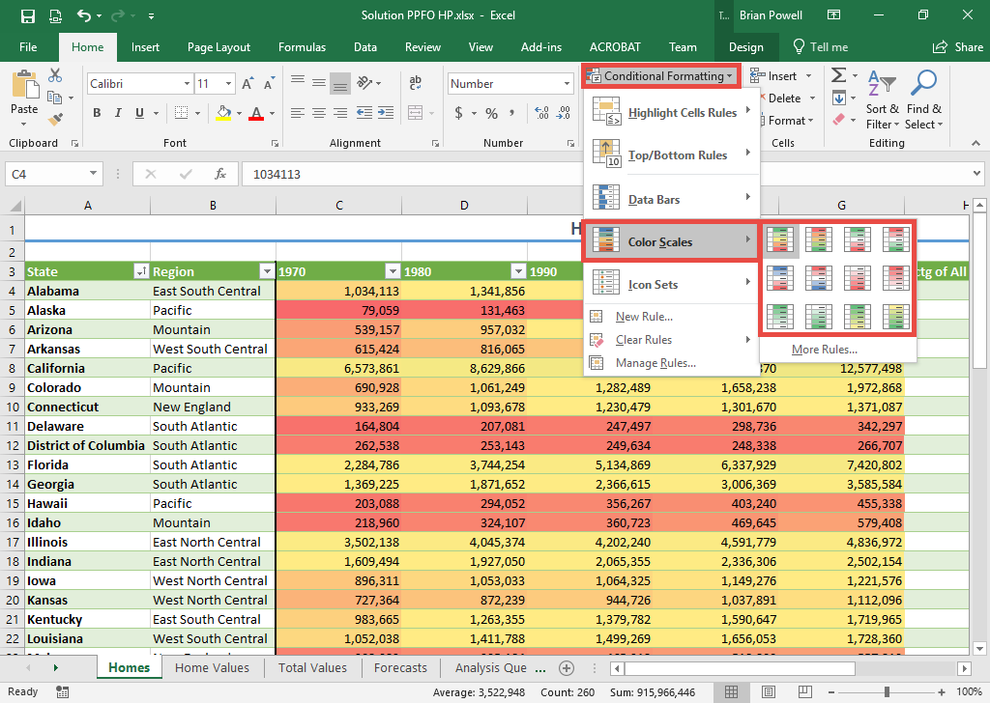
Data Visualization
Conditional Formatting
Color Scale
Color scales apply a range of colors to help easily differentiate high and low values.
Select the range of cells where you wish to apply color scale formatting.
Go to the Home ribbon.
In the Styles section, click Conditional Formatting.
Select Color Scales and then click the desired color scale.

Slide 50
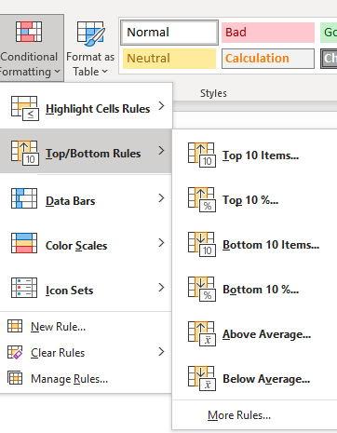
Data Visualization
Conditional Formatting
Top/Bottom Rules
Excel offers a variety of pre-set criteria for identifying and formatting cells that contain values within a numeric range. These include:
• Top/bottom items in a selected range
• Items in the top/bottom percentage of selected data
• Items which are above/below the average of the selected range
1. Select the cells to which you want to apply conditional formatting.
2. Select the Home tab.
3. From the Styles group, click on Conditional Formatting .
4. Select Top/Bottom Rules
5. From the submenu, select the criteria that you want to use: Top 10 Items..., Top 10%..., Above Average..., etc.

Slide 51

Data Visualization
Conditional Formatting
Top/Bottom Rules
6. Enter the value for the criteria, if necessary.
7. From the with drop-down list, select the formatting option that you want to apply to cells that meet the criteria.
8. Click OK.

Slide 52
Data Visualization
Conditional Formatting
Data Bars
Graphically displays the value of a cell in relation to the other selected cells, by drawing a bar at the left of the cell. The longer the bar, the higher the value in comparison to the rest.
Icon Sets
Graphically displays the value of a cell in relation to the other selected cells, by drawing symbols at the left of the cell. Different symbols represent the value of the cell in comparison to the rest.

Slide 53
Data Visualization
Conditional Formatting
Rules Manager
You can access the Conditional Formatting Rules Manager dialog box by selecting the cells that are controlled by the rules that you wish to change:
Select the Home tab
From the Styles group, click on Conditional Formatting
Select Manage Rules
In this dialog box you can specify whether you are changing the rules for the current selection of cells, the current worksheet, or another worksheet in the current workbook, before changing the order of precedence for rule evaluation and editing, adding and deleting rules as required. When you have made all the required changes, click on Apply then click on OK.

Slide 54
Data Visualization
Conditional Formatting
Rules Manager
Conditional Formatting Rules Precedence
When two or more conditional formatting rules apply to a range of cells, these rules are evaluated in order of precedence by how they are listed in the dialog box. A rule that is higher in the list has greater precedence than a rule that is lower in the list. By default, new rules are always added to the top of the list and therefore have a higher precedence; however, you can change the order of precedence by using the Move Up and Move Down arrow buttons in the dialog box.

Slide 55

Data Visualization
Conditional Formatting – Example : Quakes
Démo

Slide 56


Data Visualization
Creating Charts in Excel
Select the Insert tab.
Highlight the data.
Click on chart type, then subtype.
Use Chart Tools to customize.

Slide 57

Data Visualization
Column and Bar Charts
Excel distinguishes between vertical and horizontal bar charts, calling the former column charts and the latter bar charts.
A clustered column chart compares values across categories using vertical rectangles;
a stacked column chart displays the contribution of each value to the total by stacking the rectangles;
a 100% stacked column chart compares the percentage that each value contributes to a total.
Column and bar charts are useful for comparing categorical or ordinal data, for illustrating differences between sets of values, and for showing proportions or percentages of a whole.

Slide 58

Data Visualization
Line Charts
Line charts provide a useful means for displaying data over time.
You may plot multiple data series in line charts; however, they can be difficult to interpret if the magnitude of the data values differs greatly. In that case, it would be advisable to create separate charts for each data series.

Slide 59


Data Visualization
Pie Charts
A pie chart displays this by partitioning a circle into pie-shaped areas showing the relative proportion.
Data visualization professionals don't recommend using pie charts. In a pie chart, it is difficult to compare the relative sizes of areas; however, the bars in the column chart can easily be compared to determine relative ratios of the data.
If you do use pie charts, restrict them to small numbers of categories, always ensure that the numbers add to 100%, and use labels to display the group names and actual percentages. Avoid three-dimensional (3D) pie charts—especially those that are rotated—and keep them simple.

Slide 60

Data Visualization
Area Charts
An area chart combines the features of a pie chart with those of line charts.
Area charts present more information than pie or line charts alone but may clutter the observer’s mind with too many details if too many data series are used; thus, they should be used with care.

Slide 61

Data Visualization
Scatter Charts
Scatter charts show the relationship between two variables. To construct a scatter chart, we need observations that consist of pairs of variables.

Slide 62

Data Visualization
Bubble Charts
A bubble chart is a type of scatter chart in which the size of the data marker corresponds to the value of a third variable; consequently, it is a way to plot three variables in two dimensions.

Slide 63




Data Visualization
Démo
Miscellaneous Excel Charts
Stock chart
Surface chart
Doughnut chart
Radar chart

